Slide 1
Deep Learning for Brain Tumor Detection Using MRI
Leo Yao yy3959@nyu.edu
Tianyu Zhao tz2263@nyu.edu
Yumo Li yl10192@nyu.edu

Slide 2
Table of CONTENTS
Introduction | Introduction of Data, Methodology Used, and Paper Referenced
Data Preprocessing & Augmentation | TorchIO and Canny Edge Detector
Baseline Model | resnet
Other Models | unet, rcnn

Slide 3
01
Introduction

Slide 4
Aim
High‑impact domain
Motivation
Clinical focus
Data availability
Project goal
Method stack

Slide 5
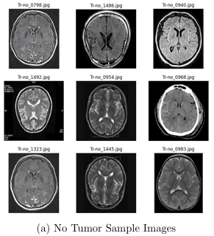
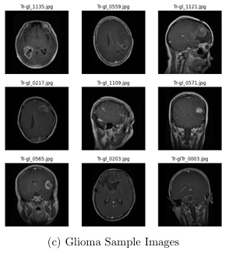
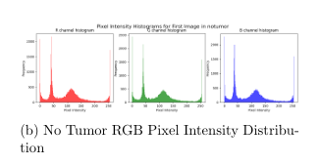
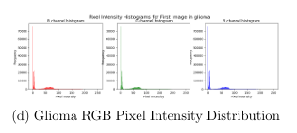
About our data

Slide 6
Methodology Used
Data Augmentation and Data Preprocessing
ResNet
U-Net and Faster R-CNN

Slide 7
Paper Referenced
Abdusalomov et al., 2023:
Brain Tumor Detection Based on Deep Learning Approaches and Magnetic Resonance Imaging
The original paper that we referenced
Ronneberger et al., 2015:
U-Net paper
Shaoqing Ren et al., 2015:
Faster R-CNN paper

Slide 8
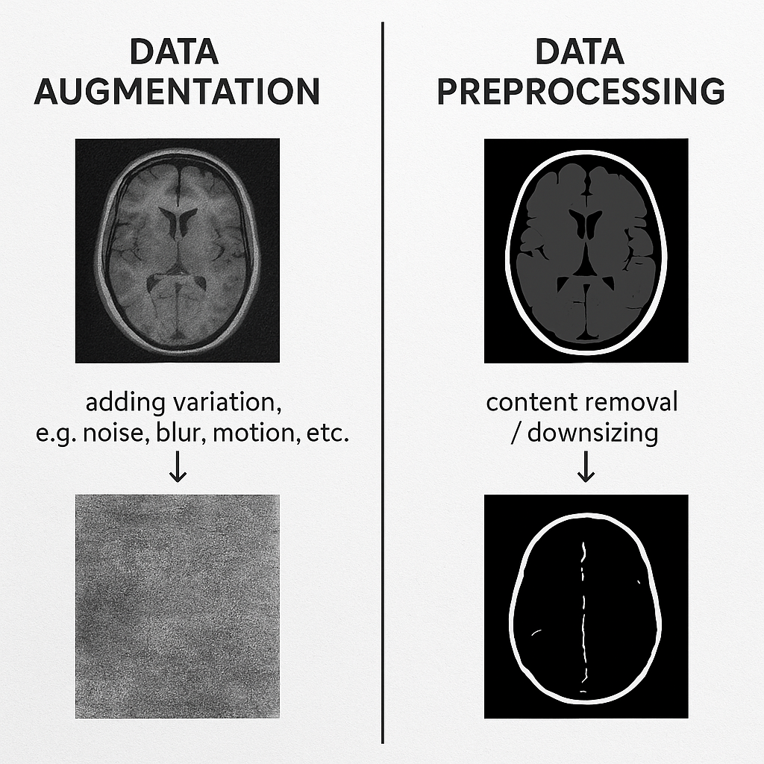
Data Augmentation and
Data Preprocessing
02

Slide 9
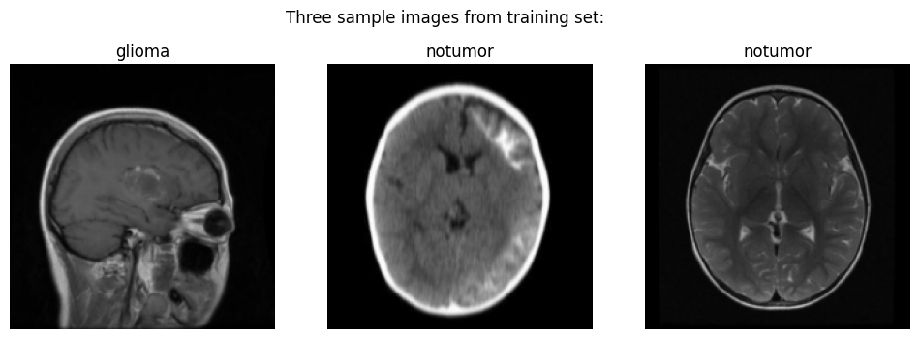
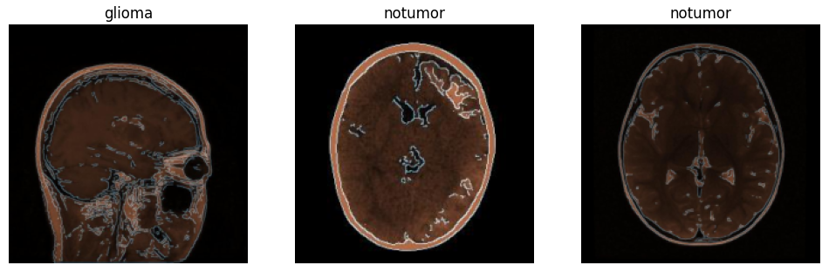
Data Augmentation (+)
TorchIO:
Random noise
Random blur
Random motion
Mix of the above
Canny Edge Detector:
Edge augmentation

Slide 10
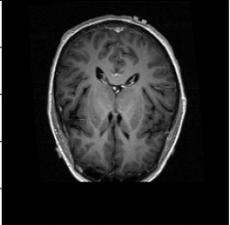
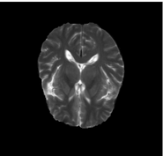
Data Preprocessing (-)
Skull Stripping

Slide 11
03
Baseline Model

Slide 12
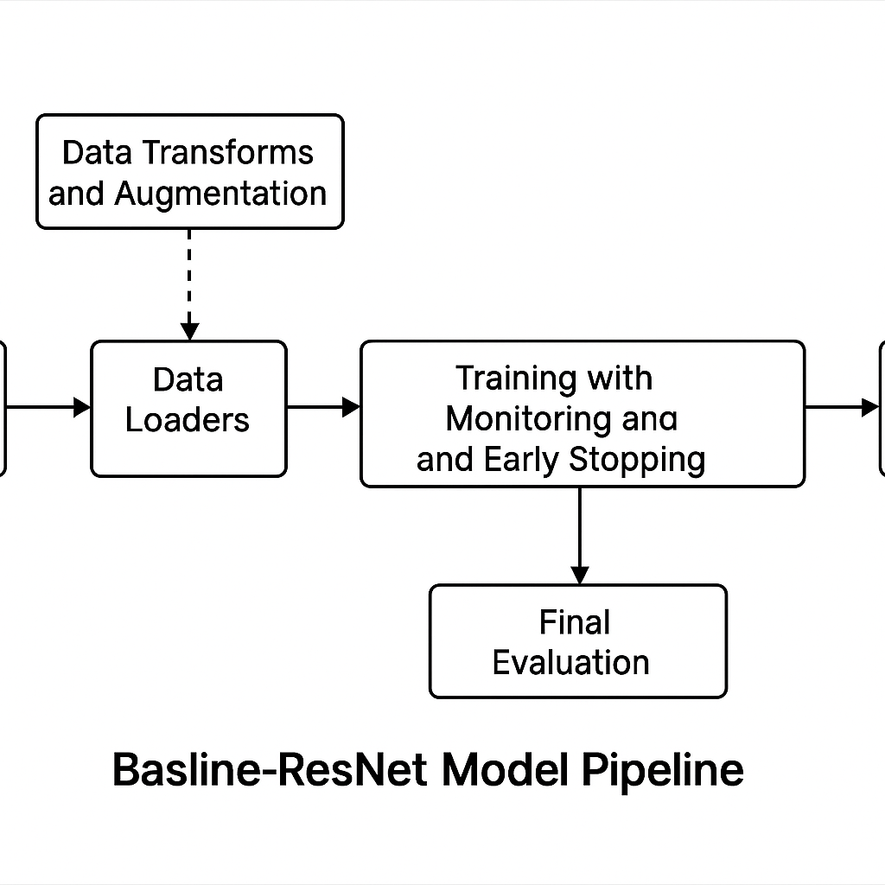
Baseline ResNet Model – Pipeline & Dataset Preparation
Data Transforms & Augmentation:
Training set:
Resize, random rotation, affine shift, horizontal flip
Normalize to standard mean and std
Validation/Test set:
Resize and normalize only
BrainTumorDataset:
Walks through class folders
Loads and labels images (OpenCV + RGB + PIL)
Applies specified transforms

Slide 13
Training, Monitoring & Evaluation
Model Architecture:
Pre-trained ResNet-50 (ImageNet weights)
Replaced final layer with:
Dropout + Linear head → 4-class output
Training Configuration:
Loss: CrossEntropyLoss
Optimizer: Adam
LR Scheduler: ReduceLROnPlateau
Monitoring: Loss, accuracy, confusion matrix (per epoch)
Training Loop:
Epoch-wise:
Train → Evaluate → Log metrics → Adjust LR
Save model if val loss improves > 0.001
Early stopping after patience epochs of no improvement
Final Evaluation:
Load best model → Run on test set
Report
Loss, accuracy
Confusion matrix
Precision, recall, F1-score per class

Slide 14
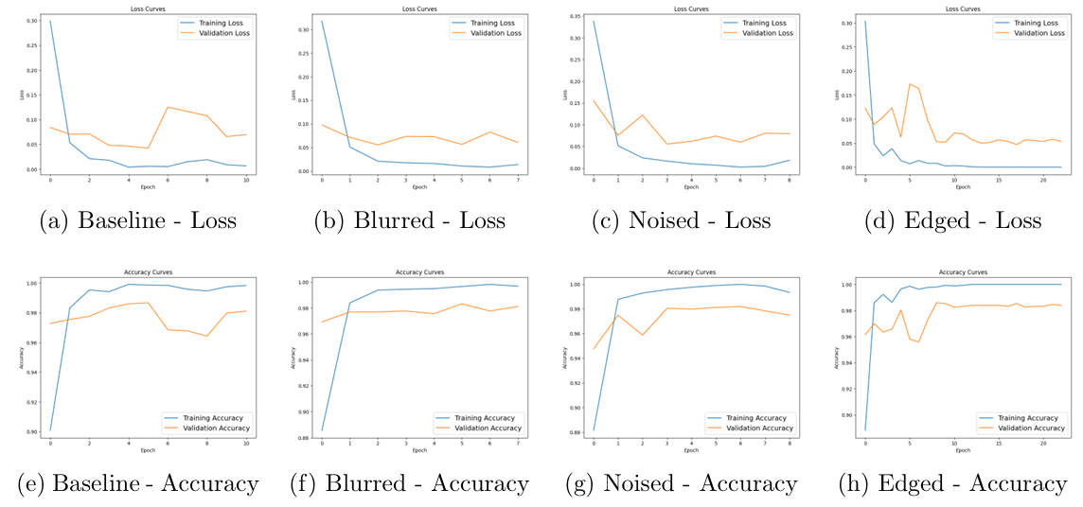
Comparison of Data Augmentation Techniques

Slide 15
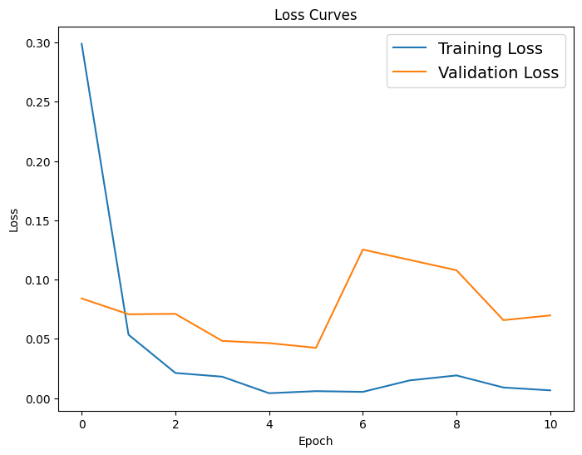
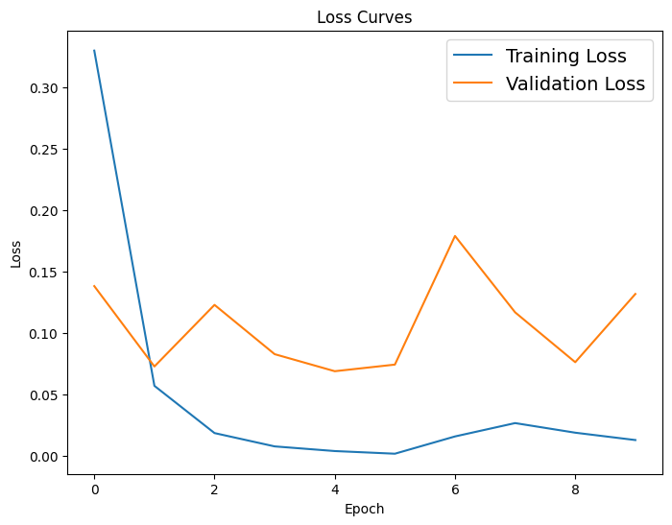
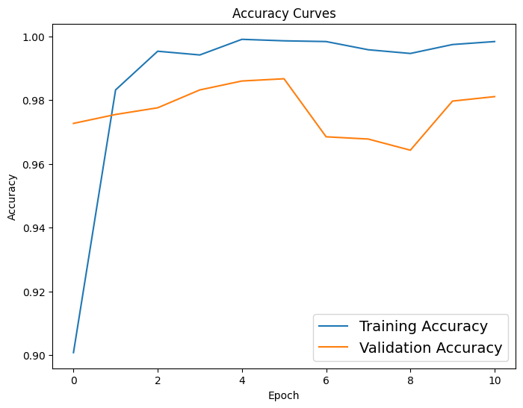
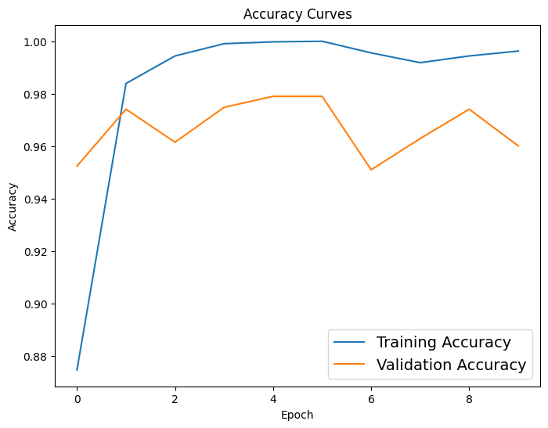
Comparison of Data Preprocessing Techniques
Baseline
Canny Edge Detector + Skull Stripping

Slide 16
04
OTHER MODELS

Slide 17
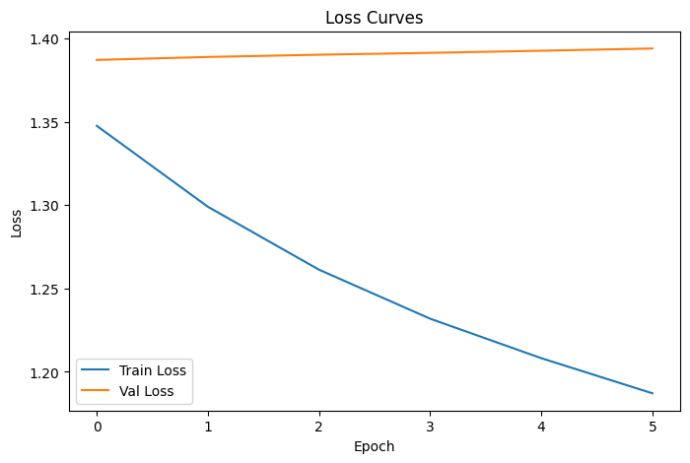
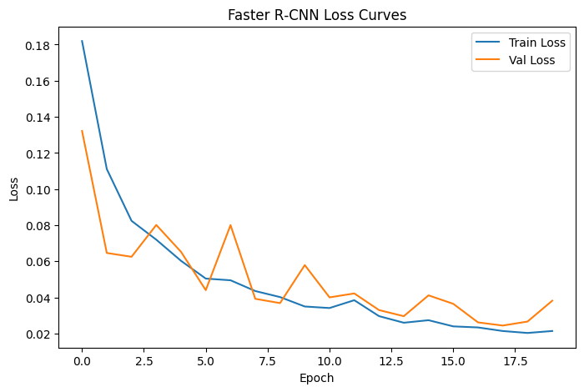
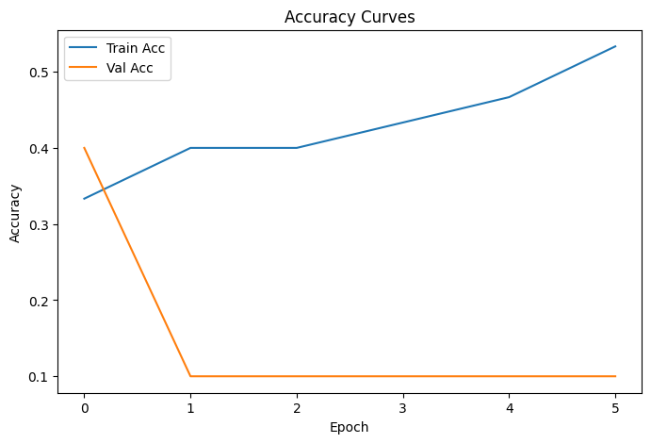
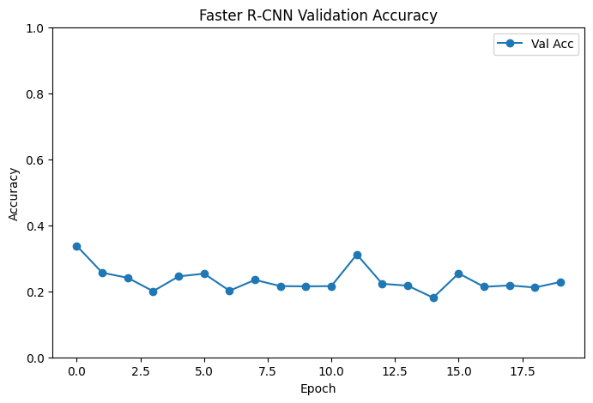
UNET and Faster R-CNN
Test accuracy: 0.3750
Test accuracy: 0.2283

Slide 18
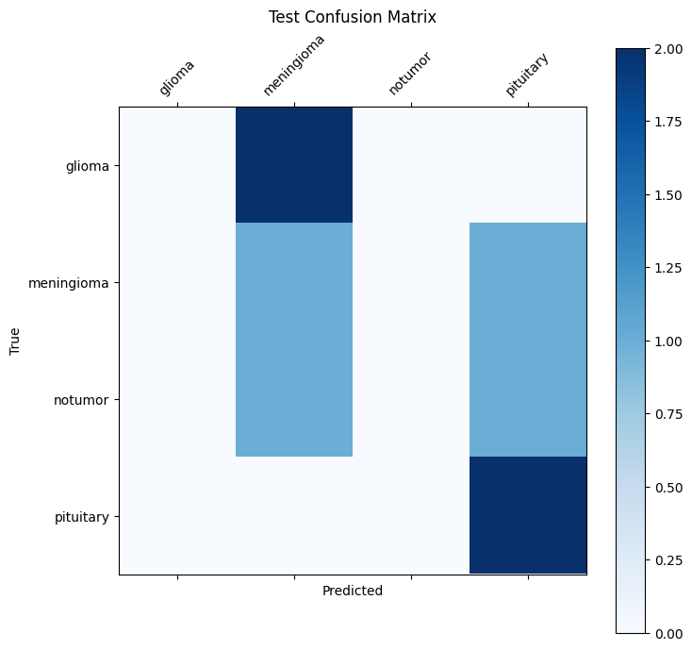
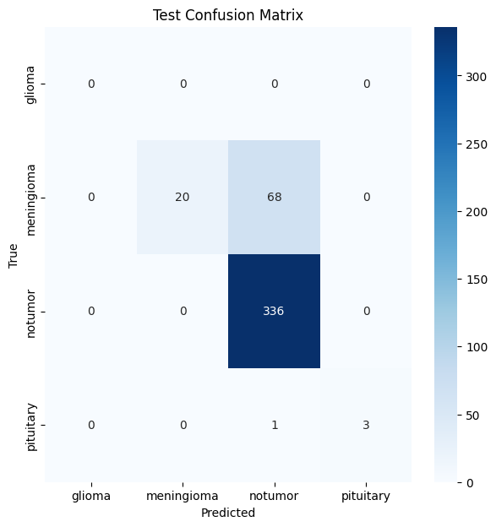

Slide 19
THANKS!

